Slide 1
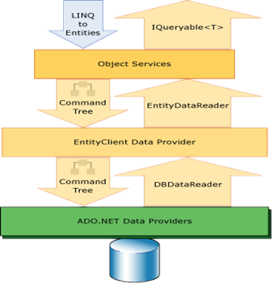

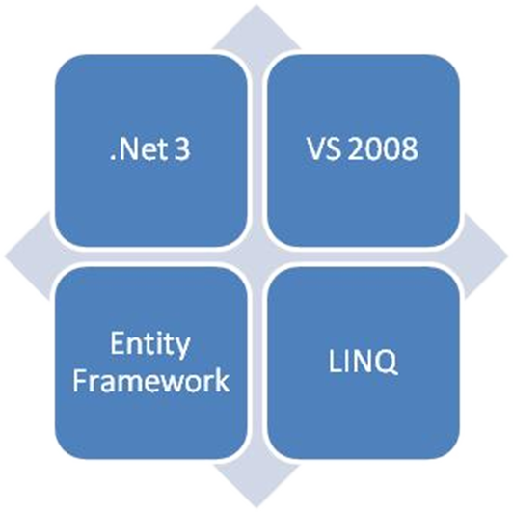
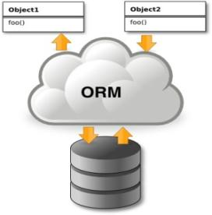
ADO.NET Entity Framework
ORM Concepts, ADO.NET Entity Framework, ObjectContext
Doncho Minkov
Telerik Corporation
www.telerik.com

Slide 2

Table of Contents
ORM Technologies – Basic Concepts
Entity Framework
Overview
Printing the native SQL queries
LINQ Components
Entity Files
The Visual Studio Designer
ObjectContenxt Class and CRUD Operations

Slide 3
Table of Contents (2)
Executing Native SQL Queries
Paramerterless Queries
Parameterized Queries
The N+1 Query Problem
Joining and Grouping Entities
Attaching and Detaching Objects

Slide 4
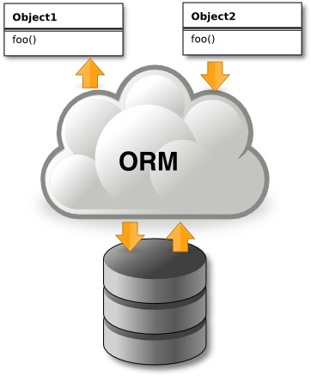
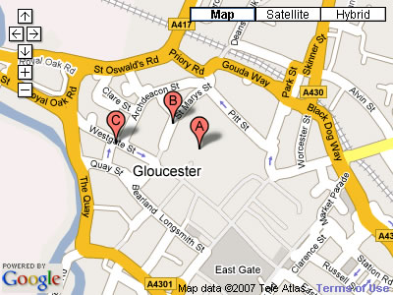


Introduction to ORM
Object-Relational Mapping (ORM) Technologies

Slide 5
ORM Technologies
Object-Relational Mapping (ORM) is a programming technique for automatic mapping and converting data
Between relational database tables and object-oriented classes and objects
ORM creates a “virtual object database“
Which can be used from within the programming language, e.g. C# or Java
ORM frameworks automate ORM process
A.k.a. object-relational persistence frameworks

Slide 6
ORM Frameworks
ORM frameworks typically provide the following functionality:
Creating object model by database schema
Creating database schema by object model
Querying data by object-oriented API
Data manipulation operations
CRUD – create, retrieve, update, delete
ORM frameworks automatically generate SQL to perform the requested data operations

Slide 7
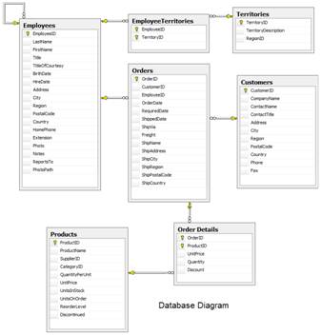
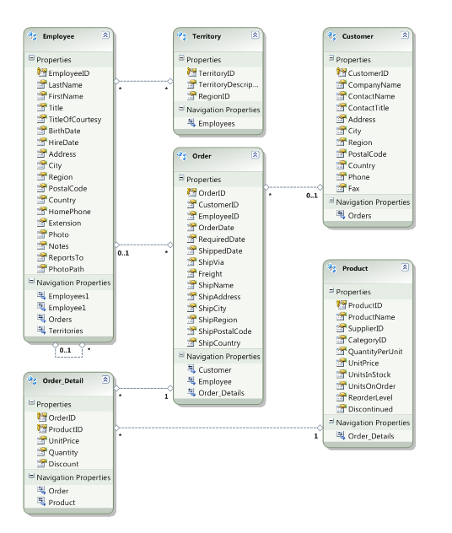




ORM Mapping – Example
Database and Entities mapping diagrams for a subset of the Northwind database
ORM Entities (C# Classes)
Relational database schema
ORM
Framework

Slide 8
ORM Advantages
Object-relational mapping advantages
Developer productivity
Writing less code
Abstract from differences between object and relational world
Complexity hidden within ORM
Manageability of the CRUD operations for complex relationships
Easier maintainability

Slide 9
Approaches to ORM
Template-based code generation vs. entity classes mappings
SQL generation (design time / runtime) vs. mapping existing SQL
Entity classes representation
Entities are just POCO (Plain Old C# Objects)
Entities implement special IPersistent interface or extend PersistentBase class
Configuring mappings
DB schema data vs. XML vs. annotations

Slide 10
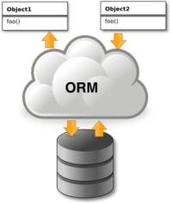
Object Persistence Frameworks
Code generation tools
Generate C#, XML and other files
Source code is compiled and used as API
Can be highly customized
Object-relational mapping tools
Mappings are described in XML files or built in the classes as attributes
No source code generation
Use of single standard API

Slide 11
ORM Frameworks in .NET
Built-in ORM tools in .NET Framework and VS
ADO.NET Entity Framework
LINQ to SQL
Both combine entity class mappings and code generation, SQL is generated at runtime
Third party ORM tools
NHibernate – the old daddy of ORM
Telerik OpenAccess ORM

Slide 12


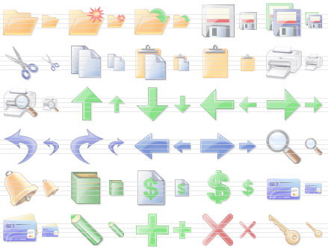
ADO.NET Entity Framework
Object Relation Mapping Framework

Slide 13
Overview of ADO.NET
Entity Framework is a standard ORM framework, part of .NET
Provides a run-time infrastructure for managing SQL Database data as .NET objects
The relational database schema is mapped to an object model (classes and associations)
Visual Studio has built-in tools for generating Entity Framework SQL data mappings
Data mappings consist of C# classes and XML
A standard data manipulation API is provided

Slide 14
Overview of ADO.NET (2)
Entity Framework is an application programming interface (API)
For working with Database Servers
Built on the top of ADO.NET and LINQ
LINQ to Entity is Microsoft’s entry-level LINQ-enabled ORM implementation for Database Servers
Works with SQL Server and SQL Server Express
Works with MySQL, Oracle etc.
Maps tables and one-to-many relationships
Maps many-to-many relationships

Slide 15
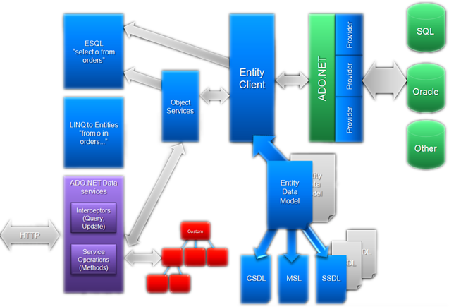
ADO.NET Entity Framework Architecture

Slide 16
Entity Framework Features
Entity Framework standard features:
Map tables, views, stored procedures and functions as objects
Provides LINQ-bases data queries
Executed as SQL SELECTs on the Database server
CRUD operations – Create/Read/Update/Delete
Create compiled queries – for executing the same parameterized query multiple times
Creating or deleting the database schema

Slide 17

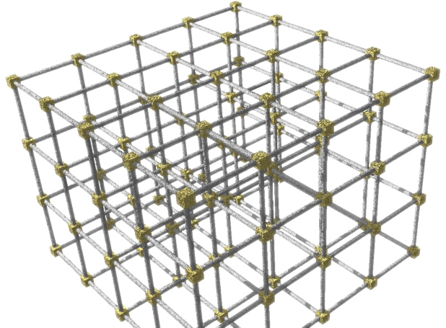
Entity Framework Lifecycle
When the application starts
Entity Framework translates into SQL the language-integrated queries in the object model
Sends them to the database for later execution

Slide 18
Entity Framework Lifecycle (2)
When the database returns the results
Entity Framework translates them back to objects
The Database is transparent, hidden behind the API
LINQ is executed over IQueryable<T>
At compile time a query expression tree is emitted
At runtime SQL is generated and executed

Slide 19
LINQ Components
The ObjectContext class
ObjectContext holds the connection to the database and the entity classes
Provides LINQ-based data access
Implements identity tracking, change tracking, and API for CRUD operations
Entity classes
Each database table is typically mapped to a single entity class

Slide 20
LINQ Components (2)
Associations
An association is a primary key / foreign key based relationship between two entity classes
Allows navigation from one entity to another, e.g. Student.Courses
Concurrency control
Entity Framework uses optimistic concurrency control
Provides automatic concurrency conflict detection and means for conflicts resolution

Slide 21
LINQ to Entity Files
Visual Studio has built-in EF data designer and code generator
Mappings are stored in .edmx files (Entity Data Model XML)
<database>.edmx is an XML file
Holds a connection string and metadata representing the database schema
<database>.cs file contains the entity classes and the ObjectContext class
One entity class for each mapped database table

Slide 22
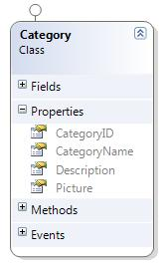
LINQ to Entity Files – Example
EDMX mappings file for the Categories table from Northwind database in SQL Server
<EntityType Name="Categories">
<Key>
<PropertyRef Name="CategoryID" />
</Key>
<Property Name="CategoryID" Nullable="false"
Type="int" StoreGeneratedPattern="Identity" />
<Property Name="CategoryName" Type="nvarchar"
Nullable="false" MaxLength="15" />
<Property Name="Description" Type="ntext" />
<Property Name="Picture" Type="image" />
</EntityType>
Entity class Category

Slide 23

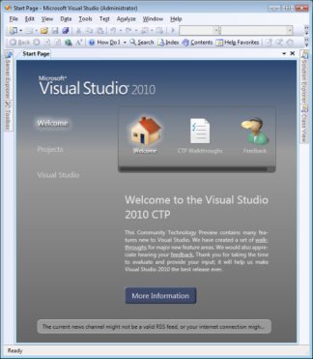

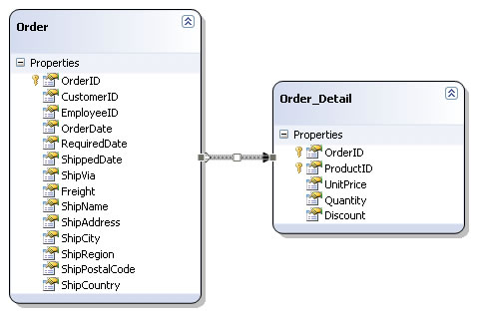
The Entity Framework Designer in Visual Studio
Live Demo

Slide 24
The ObjectContext Class
ObjectContext class is generated by the VS designer
ObjectContext provides:
Ability to manipulate Database data though entity classes (read, modify, delete, insert)
Easily navigate through the table relationships
Executing LINQ queries as corresponding native SQL queries
Create new databases using its database schema

Slide 25
Using ObjectContext Class
First create instance of ObjectContext
In the constructor you can pass a Database connection and mapping source
ObjectContext properties
Connection – the SqlConnection to be used
CommandTimeout – timeout for Database language execution
All entity classes (tables) are listed as Properties
NorthwindEntities northwindEntities =
new NorthwindEntities();

Slide 26
Logging the Native Queries
To print the native Database SQL queries call the cast the object to ObjectQuery and call the method ToTraceString();
var p = CountriesEntities.Countries;
Console.WriteLine((query as ObjectQuery).ToTraceString());
This will print the queries executed to select the Countries
Can be printed to file using StreamWriter class instead of Console class

Slide 27
Creating New Data
To create a new row use the method AddObject(…) of the corresponding collection
// Create new order object
Order order = new Order()
{
OrderDate = DateTime.Now, ShipName = "Titanic",
ShippedDate = new DateTime(1912, 4, 15),
ShipCity = "Bottom Of The Ocean"
};
// Mark the object for inserting
context.Orders.AddObject(order);
context.SaveChanges();
This will execute an SQL INSERT
SaveChanges() method call is required to perform the insert actions

Slide 28
Creating New Data (2)
Creating new row can also be done by using the AddTo+The_Entity_Name method directly on the ObjectContext
This method is depricated
Better use the other one
// Mark the object for inserting
context.AddToOrders(order);
context.SaveChanges();

Slide 29
Creating New Data with Cascading
We can also add data cascading in the database:
Country spain = new Country();
spain.Name = "Spain";
spain.Population = "46 030 10";
spain.Cities.Add( new City { Name = "Barcelona"} );
spain.Cities.Add( new City { Name = "Madrid"} );
countryEntities.Countries.AddObject(spain);
countryEntities.SaveChanges();
This way we don't have to add each City individually
They will be added when the Country Entity (spain) is inserted in the database

Slide 30
Reading Data with LINQ
Reading data from EF entity:
Customers property in the ObjectContext:
NorthwindEntities northwindEntities=
new NorthwindEntities();
var customers =
from c in context.Customers
where c.City == "London"
select c;
Transformed to SQL and is executed at the sever
public ObjectSet<Customer> Customers
{ get{
if ((_Customers == null))
{ _Customers
=base.CreateObjectSet<Customer>("Customers");
}
return _Customers;
}
}

Slide 31
Updating Data
ObjectContext allows modifying object properties and persisting them in the Database
Just load an entity, modify it and call SaveChanges()
The ObjectContext automatically tracks all changes made on its entity objects
Order order = northwindEntities.Orders.First();
order.OrderDate = DateTime.Now;
context.SaveChanges();
This will execute an SQL UPDATE
This will execute an SQL SELECT to load the first order

Slide 32
Deleting Data
Delete is done by DeleteObject() on the current entity collection
SaveChanges() method performs the delete action
Order order = northwindEntities.Orders.First();
// Mark the entity for deleting on the next save
northwindEntities.Orders.DeleteObject(order);
northwindEntities.SaveChanges();
This will execute an SQL DELETE

Slide 33



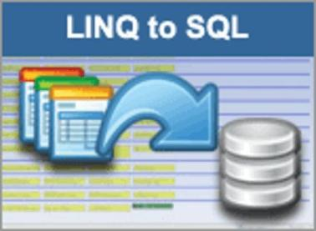


CRUD Operations with EF
Live Demo

Slide 34

Executing Native SQL Queries
Parameterless and Parameterized

Slide 35
Executing Native Queries
Examples are shown in SQL Server but the same can be done for all the other databases
In EF native queries can be executed as well
string queryString = @"SELECT VALUE
Customer FROM NorthwindEntities.Customers AS Customer
WHERE Customer.City=='London'";
var customerQuery = new ObjectQuery<Customer>(
queryString, northwindEntities);
The native SQL Query is in the queryString

Slide 36
Executing Native Queries
Native queries can also be parameterized
Can be done by using Parameters.Add(…);
string queryString = @"SELECT VALUE Customer FROM
NorthwindEntities.Customers AS Customer
WHERE Customer.City== @city";
var customerQuery = new ObjectQuery<Customer>(
queryString, northwindEntities);
customerQuery.Parameters.Add(
new ObjectParameter("city", "London"));

Slide 37



Executing Native SQL Queries
Live Demo

Slide 38
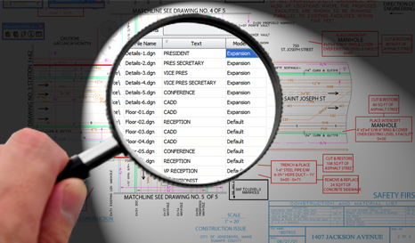
The N+1 Query Problem
What is the N+1 Query Problem?
How to avoid it?

Slide 39
The N+1 Query Problem
What is the N+1 Query Problem?
Imagine a Database that contains tables Countries and Cities
They are connected with one-to-many relationship
We want to print each Country with the its Cities:
foreach (var country in countriesEntities.Countries)
{
Console.WriteLine(country.CountryName + "\nCities:");
foreach (var city in country.Cities)
{
Console.WriteLine("{0}", city.CityName);
}
}

Slide 40
The N+1 Query Problem
N Queries to the Database (one for each Country)
One Query to the Database
foreach (var country in countriesEntities.Countries)
{
Console.WriteLine(country.CountryName + "\nCities:");
foreach (var city in country.Cities)
{
Console.WriteLine("{0}", city.CityName);
}
}
All in all N+1 queries to the Database
Imagine there are 100 Countries and each Country has at least 100 Cities
That is at least 10000 queries
Too many queries

Slide 41
Resolving the N+1 Query Problem
Fortunately there is a way to avoid this problem
Using Include(…) method only one query is made to the Database
foreach (var country in countriesEntities.Countries.
Include("Cities"))
{
foreach (var city in country.Cities)
{
Console.WriteLine(" {0}", city.CityName);
}
}
No Additional Queries are made

Slide 42

Resolving the N+1 Query Problem
Live Demo

Slide 43



Joining and Grouping Tables
Join and Group Using LINQ

Slide 44
Joining Tables
When working with EF using LINQ is available
That means that joining two Entities is the same as joining two collections
Using Join Extention Method
northwindEntities.Customers.
Join(northwindEntities.Suppliers,
(c=>c.Country), (s=>s.Country), (c,s)=>
new {Customer = c.CompanyName, Supplier =
s.CompanyName, Country = c.Country });
var customerSupplier =
from customer in northwindEntities.Customers
join supplier in northwindEntities.Suppliers
on customer.Country equals supplier.Country
select new {
CustomerName = customer.CompanyName,
Supplier = supplier.CompanyName,
Country = customer.Country
};

Slide 45
Grouping Tables
Grouping also can be done by using LINQ
Again grouping is the same as with a collection in LINQ
Using LINQ
var groupedCustomers =
from customer in northwindEntities.Customers
group customer by Customer.Country;
Using Extension Methods
var groupedCustomers =
northwindEntities.Customers.GroupBy(
customer => customer.Country);

Slide 46


Joining and Grouping Tables
Live Demo

Slide 47
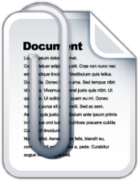

Attaching and Detaching Objects

Slide 48
Attaching and Detaching Objects
In the Entity Framework, objects can be attached to or detached from an object context
Attached objects are tracked and managed by the ObjectContext
Detached objects are not referenced by the ObjectContext

Slide 49

Attaching Detached Objects
When a query is executed inside an ObjectContext, the returned objects are automatically attached to it
You might attach objects that have been previously detached

Slide 50
Detaching Objects
When an object is detached?
When we obtain the object from an ObjectContext and the Dispose it
Detach the object manually
By calling the Detach(…) method of the entity set
Product GetProduct(int id)
{
using (NorthwindEntities northwindEntities =
new NorthwindEntities())
{
return northwindEntities.Products.First(
p => p.ProductID == id);
}
}

Slide 51
Attaching Objects
When we want to update the detached object we need to reattach it and the update it
Done by the Attach(…) method of the entity set
void UpdateProduct(Product product)
{
using (NorthwindEntities northwindEntities =
new NorthwindEntities())
{
northwindEntities.Products.Attach(product);
product.UnitPrice = 123m;
northwindEntities.SaveChanges();
}
}

Slide 52

Attaching and Detaching Objects
Live Demo

Slide 53

LINQ to SQL
?
?
?
Questions?
?
?
?
?

Slide 54
Homework
Using the Visual Studio Entity Framework designer create a ObjectContext for the Northwind database
Create a DAO class with static methods which provide functionality for inserting, modifying and deleting customers. Write a testing class.
Write a method that finds all customers who have orders made in 1997 and shipped to Canada.
Implement previous by using native SQL query and executing it through the ObjectContext.
Write a method that finds all the sales by specified region and period (start / end dates).

Slide 55
Homework (2)
Create a database called NorthwindTwin with the same structure as Northwind using the features from ObjectContext. Find for the API for schema generation in MSDN or in Google.
Try to open two different data contexts and perform concurrent changes on the same records. What will happen at SaveChanges()? How to deal with it?
By inheriting the Employee entity class create a class which allows employees to access their corresponding territories as property of type EntitySet<T>.

Slide 56
Homework (3)
Create a method that places a new order in the Northwind database. The order should contain several order items. Use transaction to ensure the data consistency.
Create a stored procedures in the Northwind database for finding the total incomes for given supplier name and period (start date, end date). Implement a C# method that calls the stored procedure and returns the retuned record set.

